Slide 1



Mental Health Awareness
A Step Towards Supporting Mental Wellness

Slide 2
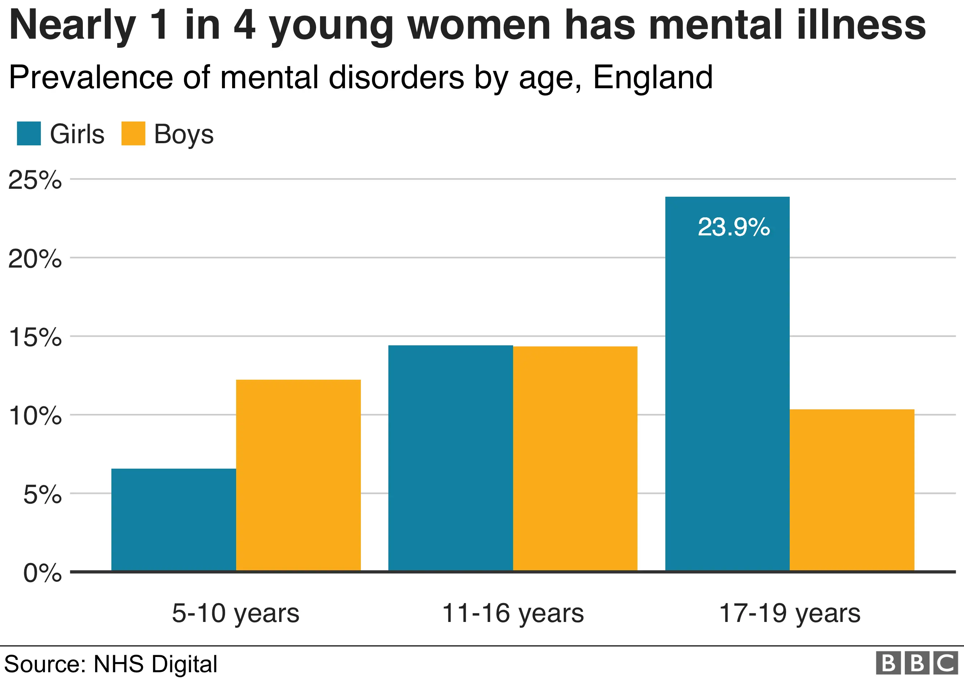
Importance of Mental Health
Why is Attention to Mental Health Needed?
Mental health is essential for overall well-being and quality of life.
Rising cases of anxiety, depression, and stress in modern society.
Lack of accessible resources for mental health support.
Breaking stigma and promoting awareness.

Slide 3
How Our Website Helps
Provides resources and tools for mental health support.
Offers detailed information on mental health issues and tips to improve psychological well-being.
User-friendly interface designed for easy navigation.
Focused on accessibility and inclusivity for all users.
Access to renowned doctors with vast experience in treating mental health conditions.

Slide 4
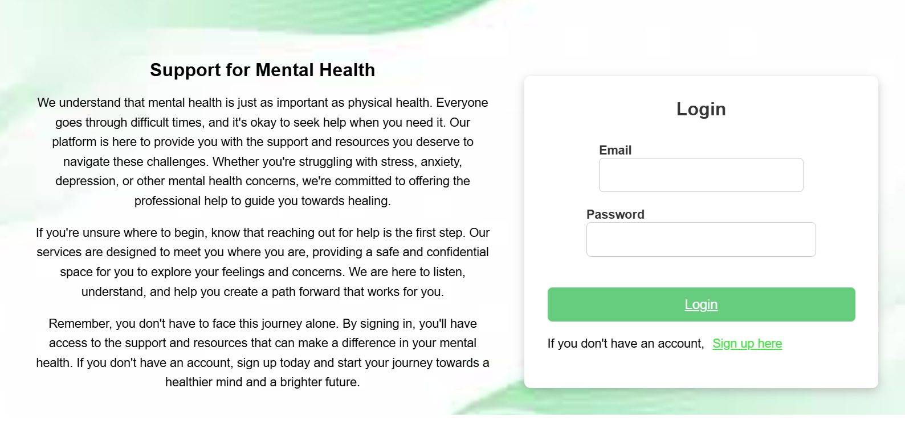
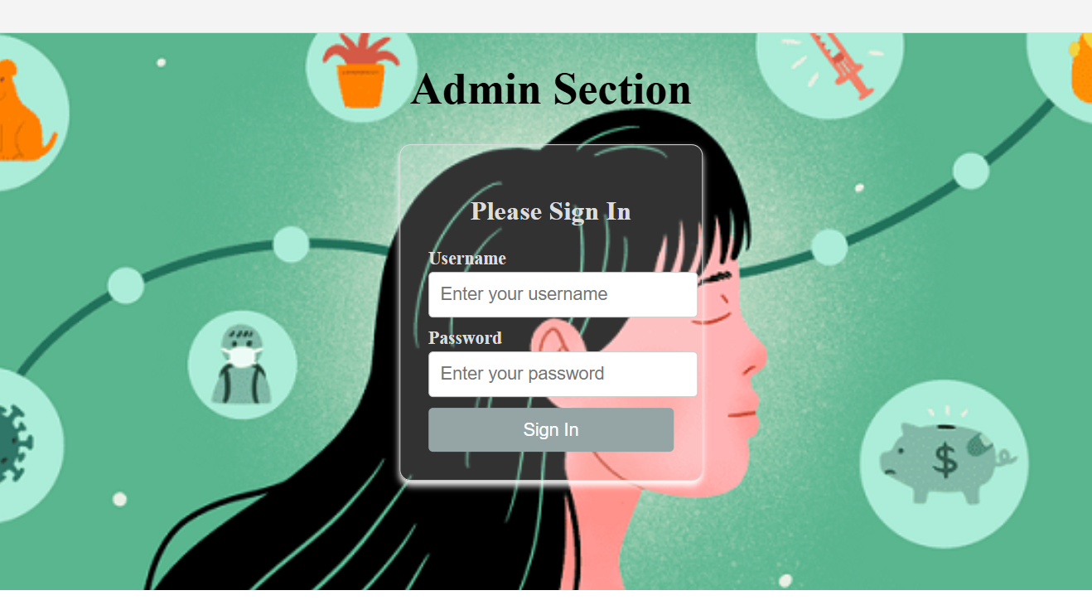
Website Features
Pages and Screens Overview
Home Page
Patient:
Registration, Login and Dashboard
Admin:
Login and Dashboard

Slide 5
Technologies Used
Angular.Js
Java
MySQL
Technology Stack:
Frontend: HTML, CSS, JavaScript, Angular
Backend: Node.js, Java
Database: MySQL

Slide 6
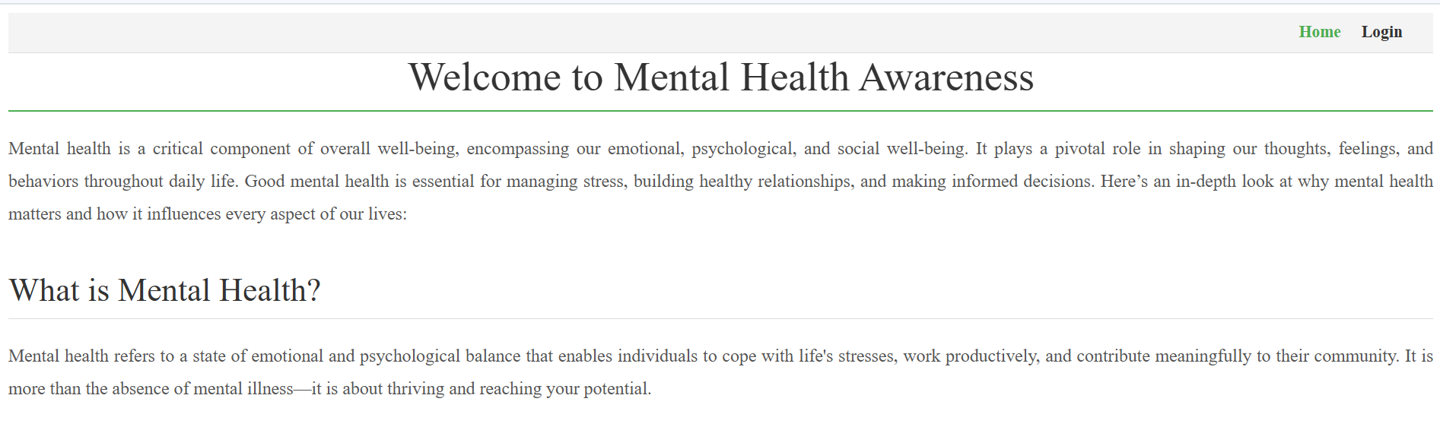
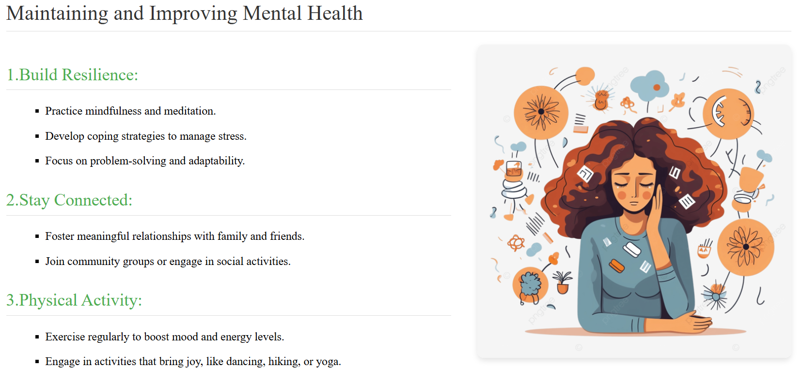
Frontend Implementation
User Interface and Experience
Website references:
Responsive design for accessibility across devices.
Intuitive navigation for seamless user experience.
Use of CSS frameworks for styling.
Integration of interactive elements (ex: tables, forms).

Slide 7
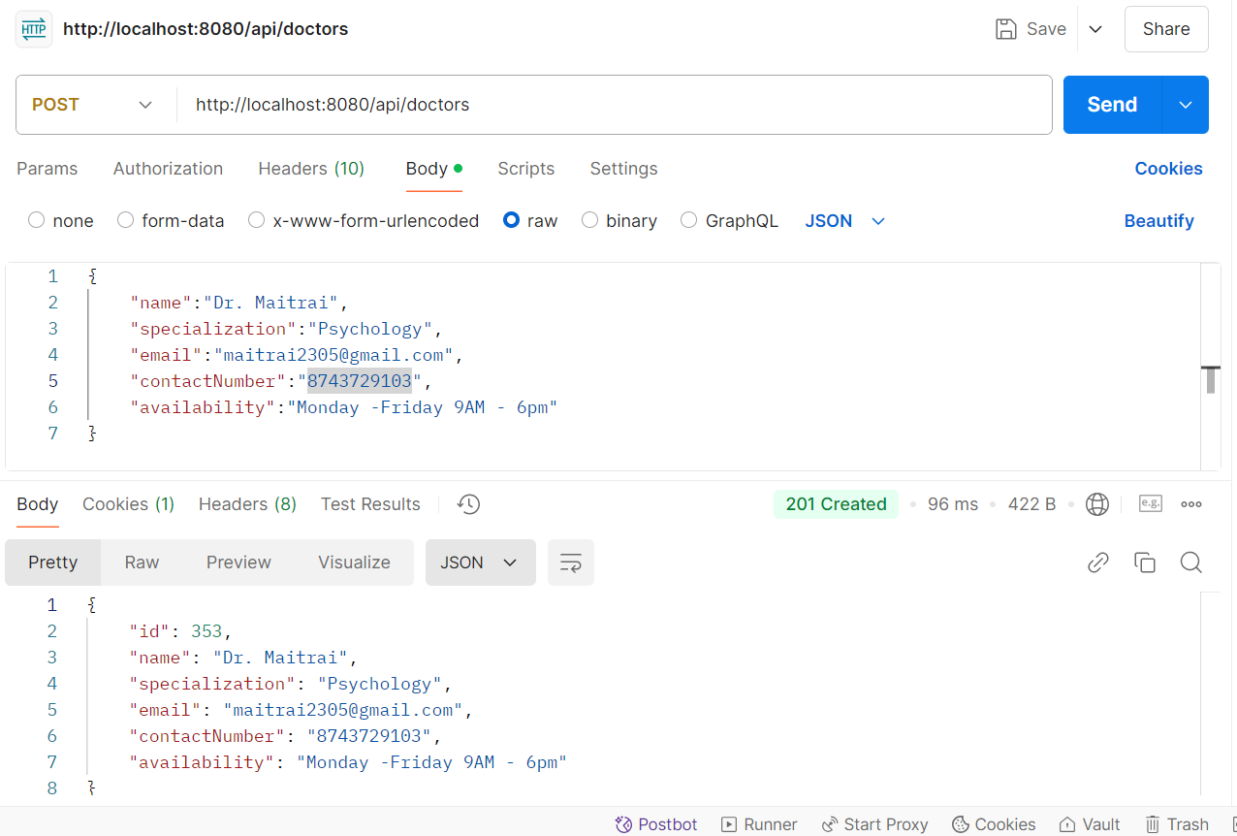
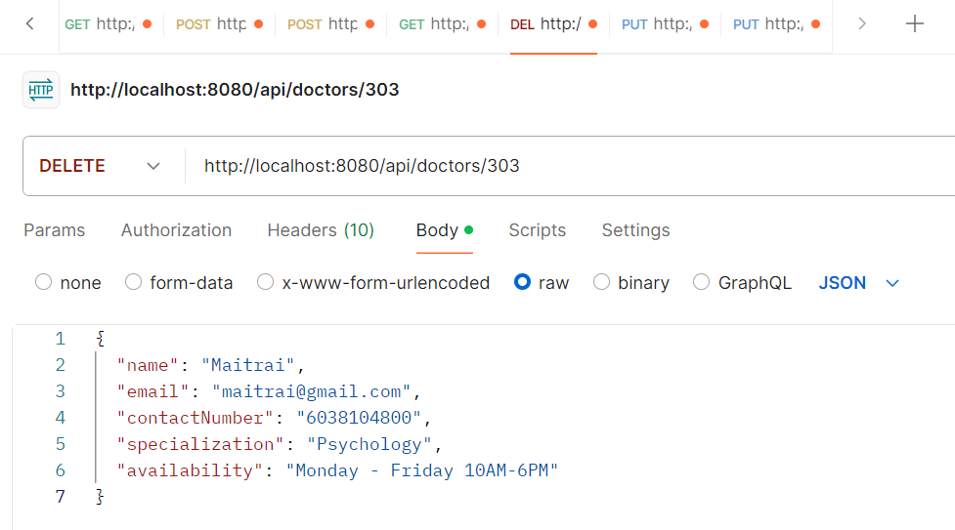
Backend and Database Implementation
Robust Backend and Data Handling
Backend API development for seamless data flow and operations.
Database schema design using MySQL for efficient data storage and retrieval.
Data creation and mocking facilitated using Postman for testing and validation.
Edit and delete operations implemented for managing the doctor list effectively.

Slide 8
Conclusion and Future Scope
Wrapping up and looking ahead
Our Mental Health project provides accessible resources and expert guidance to support mental well-being. With its user-friendly design and impactful features, the platform has great potential for growth. Future plans include AI chatbots for real-time help, mobile app integration, and personalized user experiences, ensuring continuous support for mental health awareness.

Slide 9
Thank You

